Slide 1
ECE 313: PROBABILITY WITH ENGINEERING APPLICATIONS
Fall 2023
Prof. Eric Chitambar
Lecture 8

Slide 2



Independent Random Variables

Slide 3


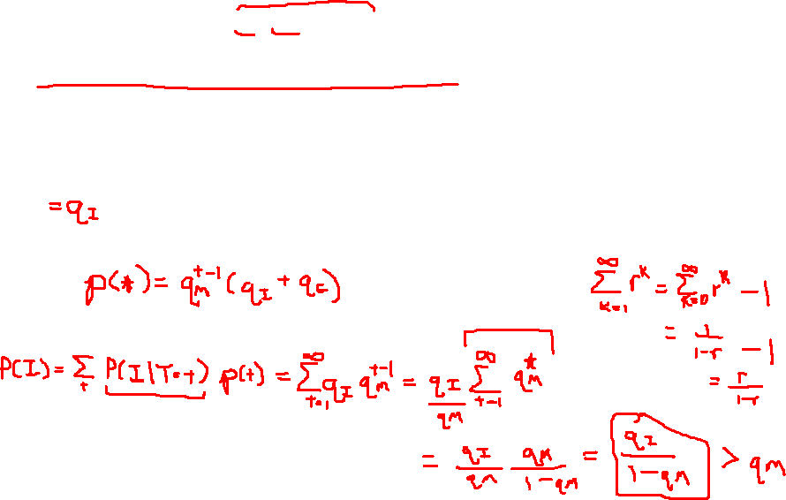
Independent Random Variables

Slide 4

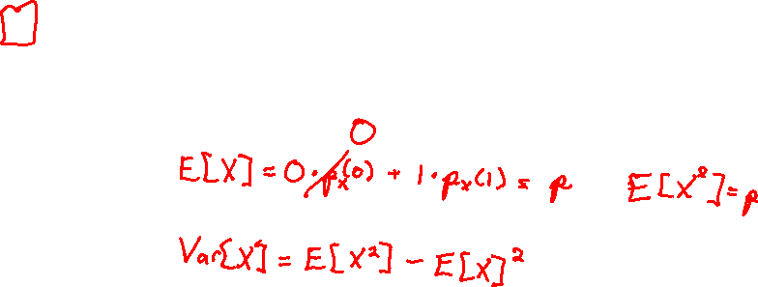
The Bernoulli Distribution

Slide 5

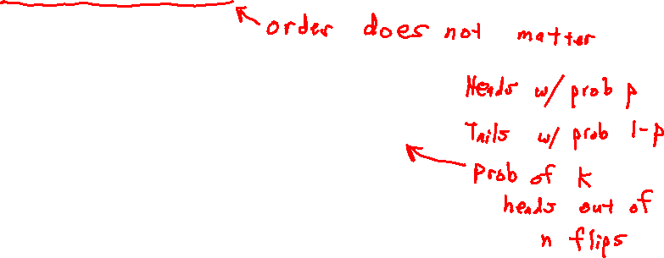
The Binomial Distribution

Slide 6

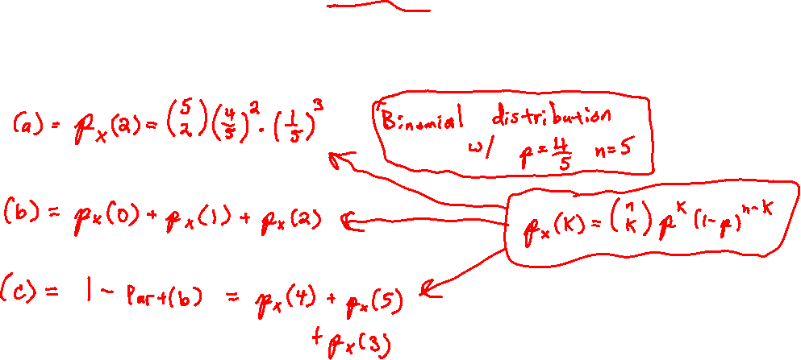
The Binomial Distribution

Slide 7

The Binomial Distribution

Slide 8



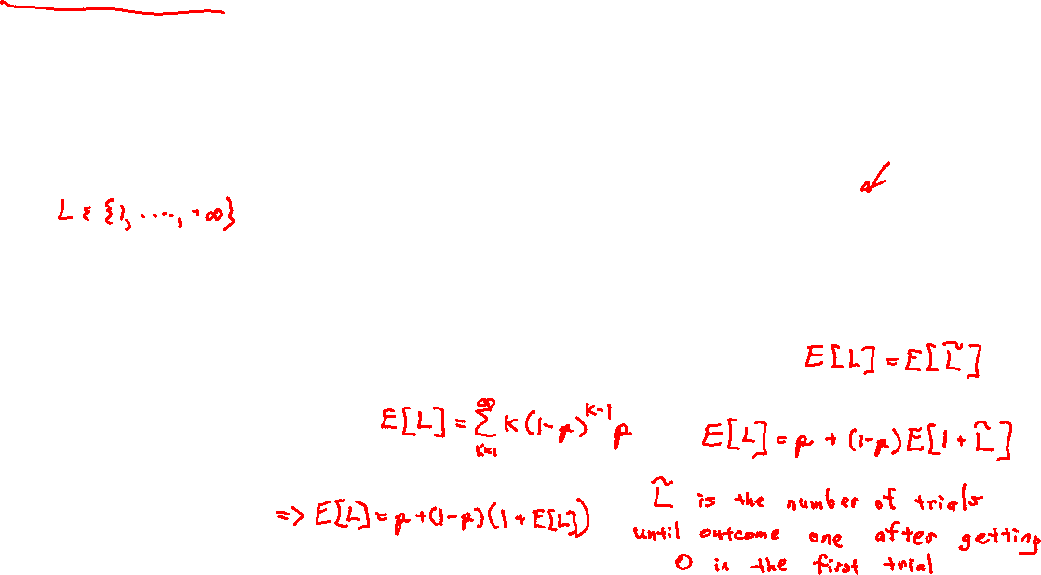
Geometric Distribution

Slide 9

Geometric Distribution

Slide 10


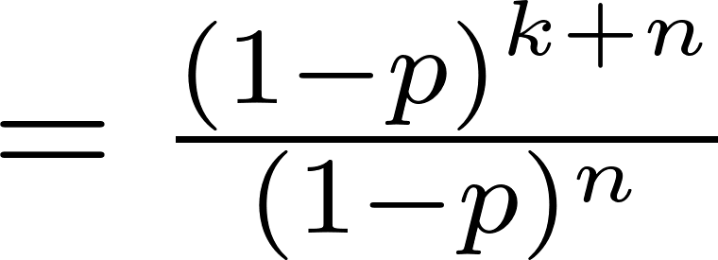


Geometric Distribution

Slide 11
Geometric Distribution

